Slide 1

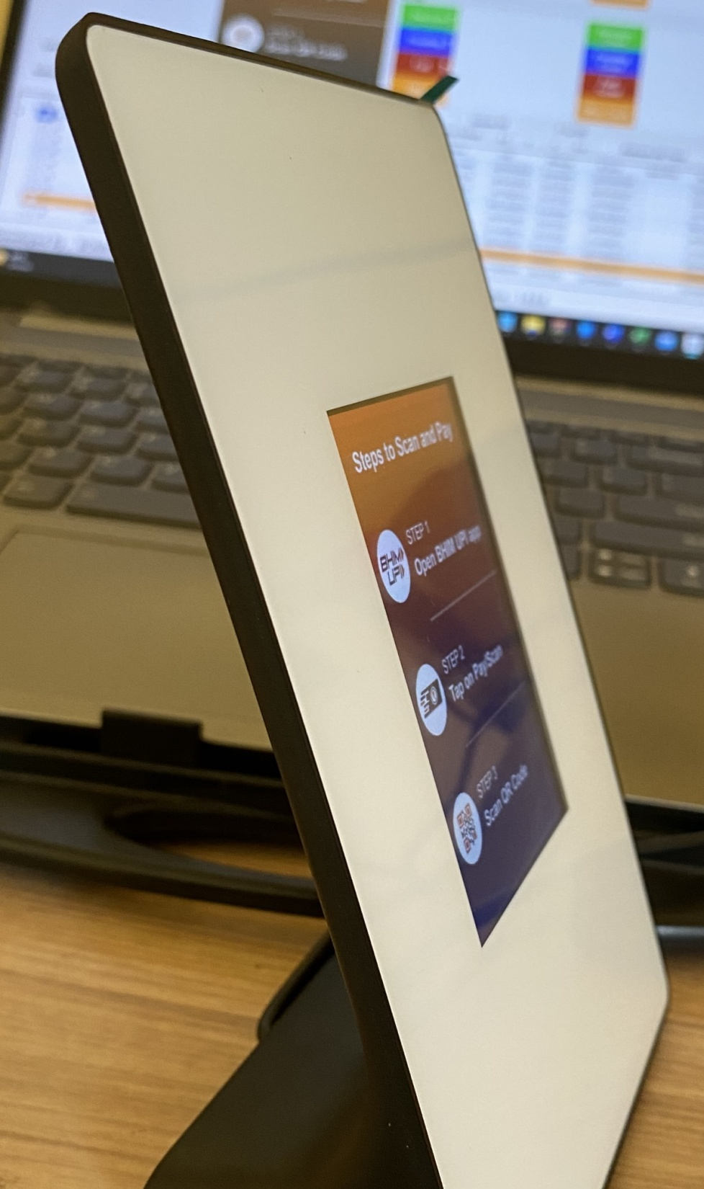
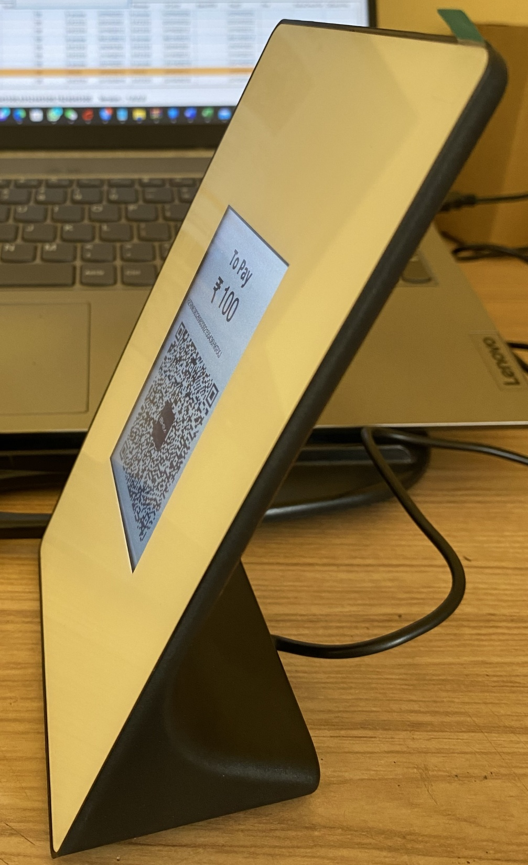
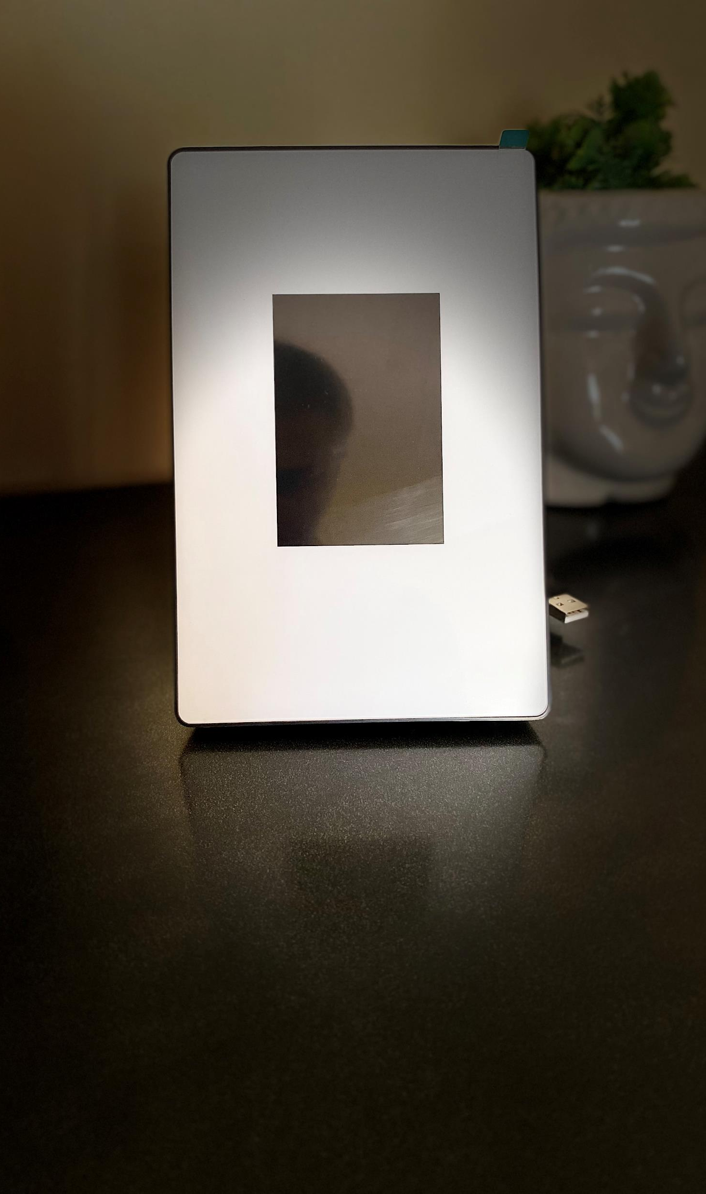
Most Suitable product to Accept payment through UPI Billing system/POS
Processor 32-bitsARM
Display 3.5”TFTLCD, 320*480 pixels
USB Cable 1.2m，TypeAUSBplug
Communication USB CDC Serial port
Weight 170g±10g

Slide 2
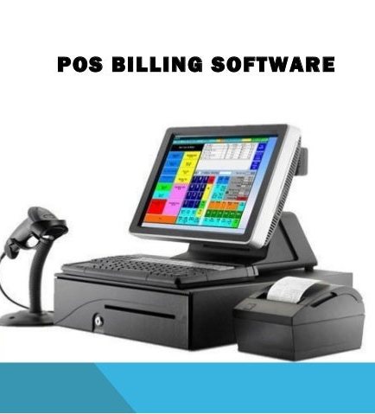
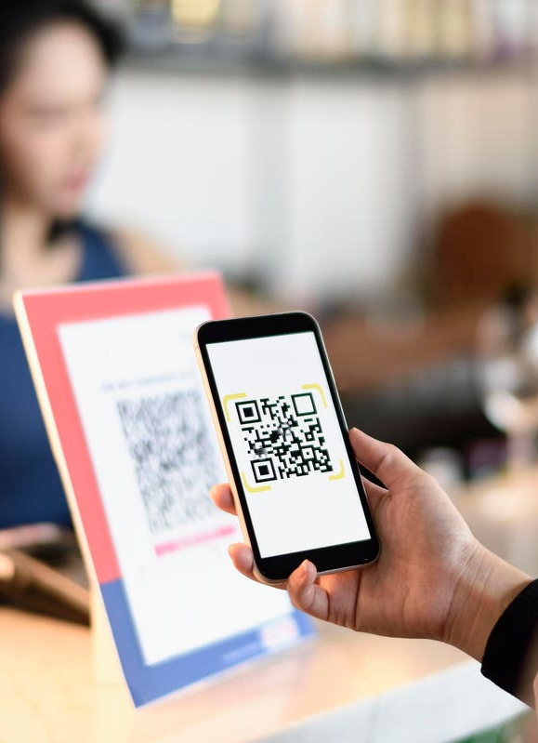
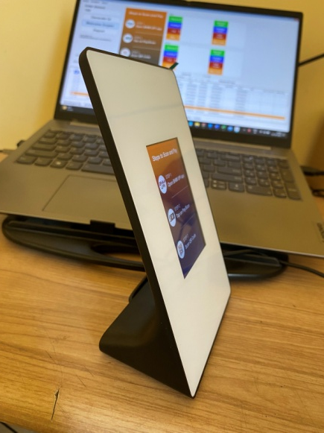
Benefit
Customer scan and make
Payment
QR image send to DQR
Payment status display
on screen
POS/Billing software Generate QR code
Merchant control the amount
Customer don’t need to enter amount
Each QR code generated by a merchant for an order is unique.
UPI Settlement can match with Billing system order and amount
Accept payment by any UPI app and have status report at same time
Configure any UPI code & easy to change

Slide 3
Dynamic QR display device use cases
Grocery shop
Shopping store
Railway Ticket counter
Govt and private Hospital
LIC Billing counter
Post office Billing counter
Bus Ticker counter
Exhibition Ticker counter
Petrol Pump
Restaurant/ Hotel
Customer visit
Pick the product to buy
Merchant scan product code
Bill generated
Unique UPI code transfer on DQR
Customer make payment
Payment and invoice print
Record of every transaction with invoice number
Customer visit to counter
Buy product and service
Bill/ticker generated
QR code transfer on DQR
Customer make payment by UPI
Payment information updated in system
Ticker/Bill printer

